Slide 1
A Novel Potential Drowning Detection System Based on Millimeter-Wave Radar
Xuliang Yu¹, Zhihui Cao¹, Zhijing Wu¹,
Chunyi Song^{1,2,3}, Jiang Zhu^{1,2,3}, Zhiwei Xu^{1,2,3}
¹ Ocean College, Institute of Marine Electronics and Intelligent Systems, Zhejiang University
² Engineering Research Center of Oceanic Sensing Technology and Equipment, Zhejiang University
³ Donghai Lab, Zhou Shan
^{Email: cysong@zju.edu.cn}
For 17th International Conference on Control, Automation, Robotics and Vision (2022 ICARCV)

Slide 2
Outline
1 Problem Description
2 Conventional Solution
3 Motivation
4 System Overview
5 Network Structure
6 Experimental Analysis
7 Conclusion and Future Work

Slide 3
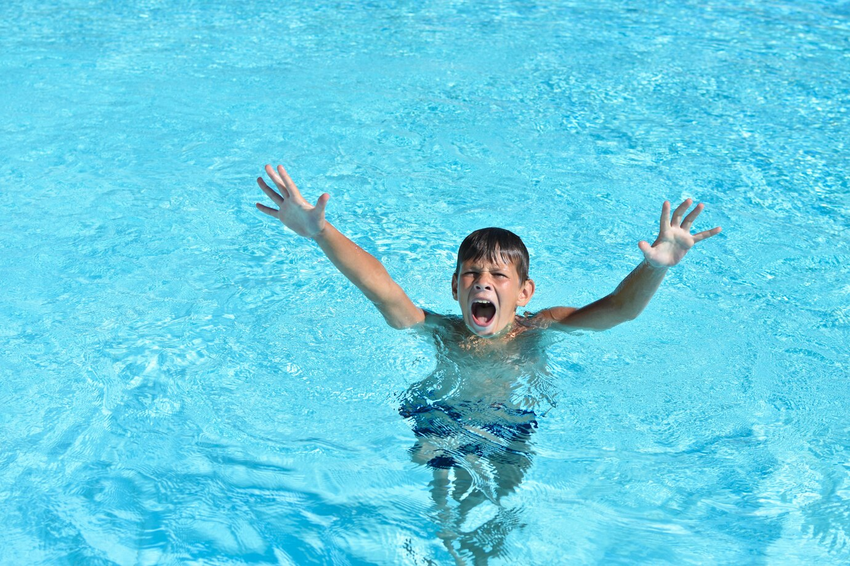
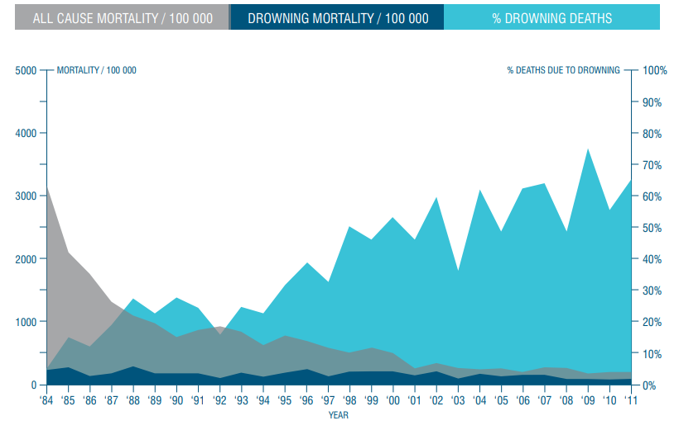
Problem Description
What is drowning ?
An insidious process in which breathing is impaired due to submersion or immersion in a liquid medium.
Drowning are insidious, rapid and fatal.
How about drowning ?
2019 WHO Global Drowning Report: Drowning accounts for the third leading cause of unintentional injury deaths.
Drowning occurs in a wide variety of environments such as pools, rivers, ponds and oceans.
Fig. 1 Drowning illustration
Drowning detection helps sound aquatic target search and rescue system.
Fig. 2 2019 WHO drowning report

Slide 4
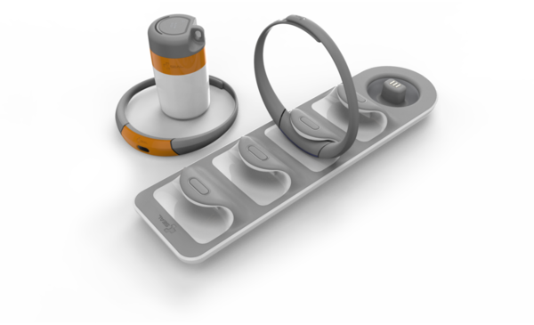
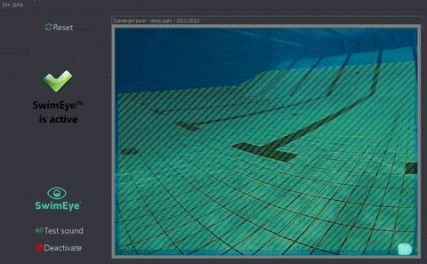
Conventional Solution
Sensor-based wearable devices
How work: using various high-precision sensors to achieve real-time monitoring of physiological parameters and environmental indicators of users when in water
Main challenge: difficult to achieve ease-of-use and mass popularization.
Fig. 3 Wearable devices
Vision-based detection systems
How work: using cameras to monitor the status of targets in the environment in real time to achieve target tracking, detection and identification.
Main challenge: low privacy safety and low performance in low illumination and obstruction concealment.
Fig. 4 Video-based system

Slide 5
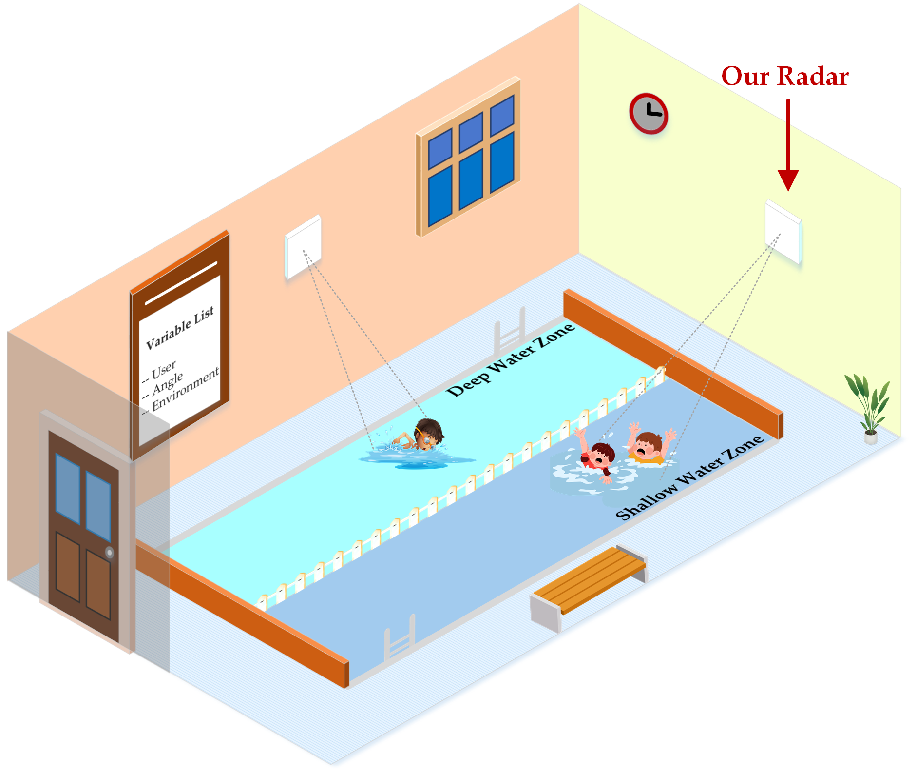
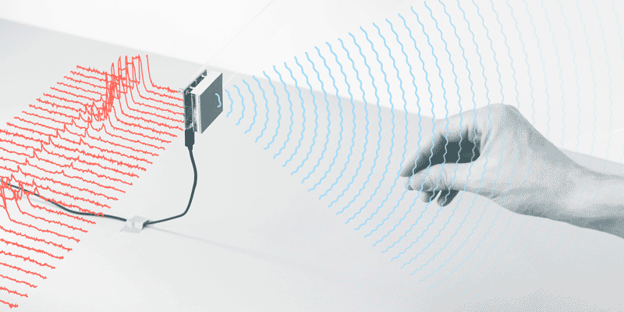
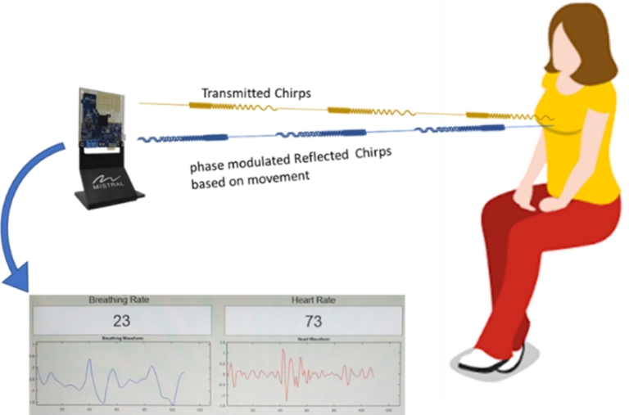
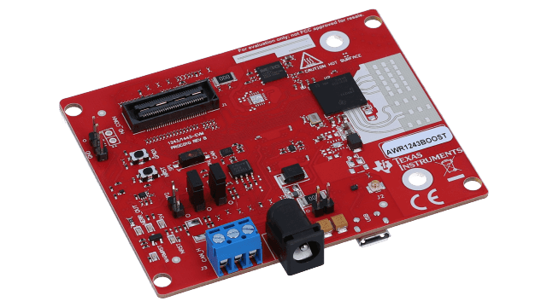
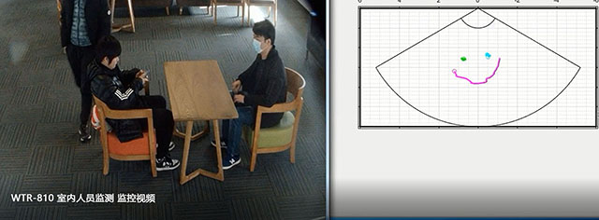
Motivation
Whether millimeter wave radar can infuse
fresh blood into potential-drowning detection ?
Capability: detailed structure capture capability even under severe conditions, round-the-clock workability and robust contactless privacy-safety.
Application: human gesture/gait/identity/activity recognition; human heart/breath sign detection; target tracking and localization.
?
Fig. 5 Mm-wave radar application

Slide 6
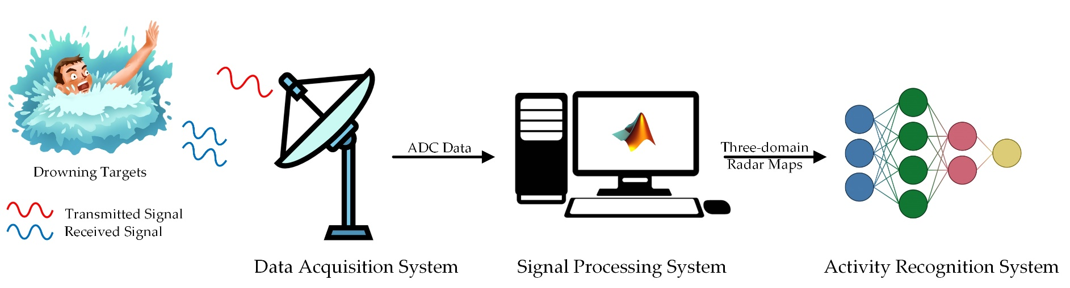
System Overview
Fig. 6 Mm-wave radar-based drowning detection system
Data acquisition module: combine the transmitted chirps and received chirps to generate intermediate-frequency signals.
Signal processing module: process the raw radar data into radar images via unified signal processing pipeline.
Event detection module: achieve aquatic human activity recognition based on the proposed two-stage fusion network (TSFNet).

Slide 7
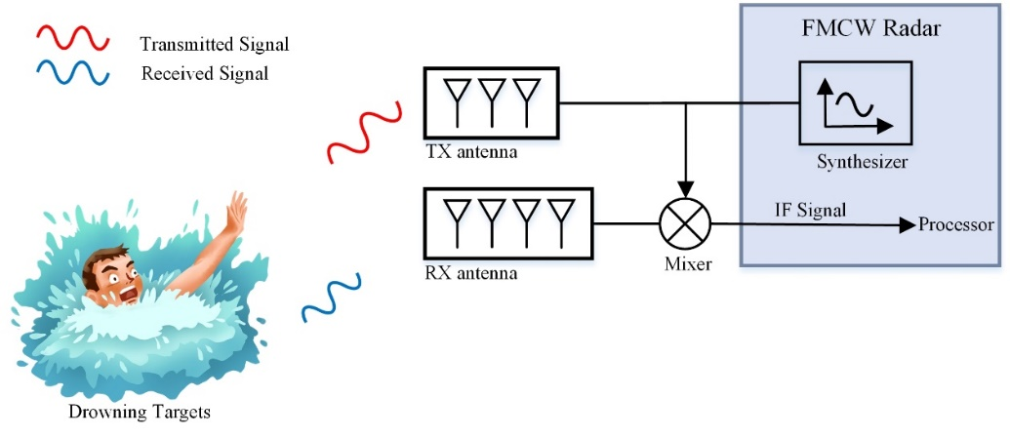
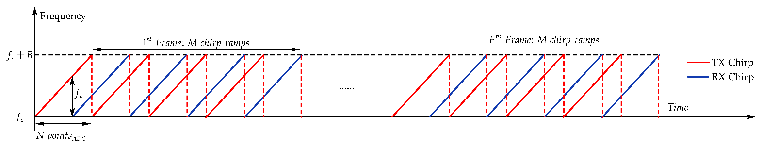
System Overview
Data Acquisition System
FMCW radar transmits F chirp-sequence cycles with M chirp ramps per cycle and N ADC sampling points per chirp.
The mixer combines the transmitted and received signals to get IF signals with f_{b} frequency.
The raw radar IF signals are usually discrete sampled and then transmitted as packets to the signal processing module via ethernet communication.
Fig. 7 Data acquisition pipeline
Fig. 8 FMCW chirps illustration

Slide 8
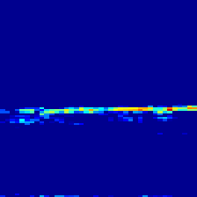
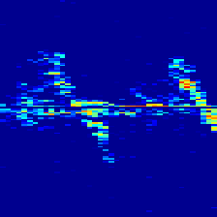
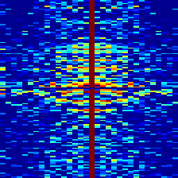
System Overview
Signal Processing System
Radar signal is with rich multi-domain and multi-dimensional information.
From the time-range maps (TRM), we can reveal the displacement of the target relative to the radar over a period of time.
From the time-Doppler maps (TDM), we can either analyze whether the current target is at rest or in movement, and we can perform fine-grained recognition of different behaviors by feature extraction and identification methods.
From the cadence-velocity diagrams (CVD), we can reveal the periodic features, size, frequency and shape information of targets.
(a)
(b)
Fig. 9 Multi-domain radar maps. (a) time-range maps (TRM) (b) time-Doppler maps (c) cadence-velocity diagrams (CVD)
(c)

Slide 9
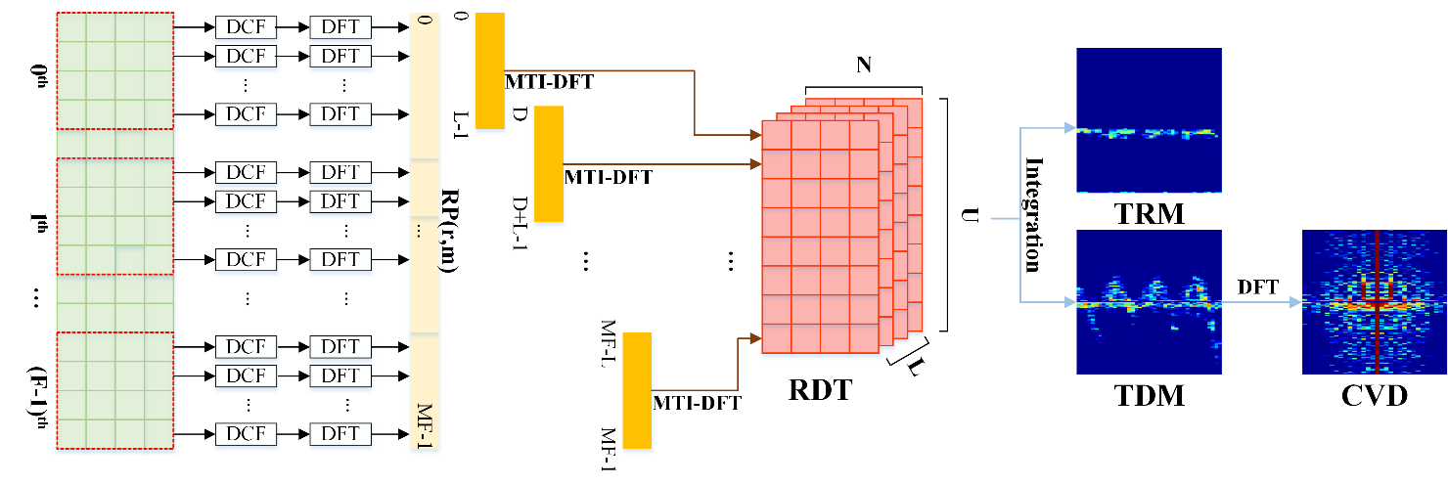
System Overview
Signal Processing System
The range profiles (RP) can be acquired by conducting DC filtering (DCF) and discrete Fourier transform (DFT) for each chirp across the fast-time dimension.
The RDT can be available by taking moving target indication (MTI) and DFT along the slow-time dimension separately for U overlapping signal segments of RP, which is called STFT as well.
Fig. 10 Signal processing pipeline

Slide 10
System Overview
Signal Processing System
The time-range map (TRM) and time-doppler map (TDM) is derived by integrating the RDT tensor along either the doppler dimension or the range dimension, correspondingly.
The cadence velocity diagram (CVD) to reveal the periodic features of the target by taking DFT on TDM along the cycle time axis for each doppler frequency bin.
Fig. 10 Signal processing pipeline

Slide 11
System Overview
Event Detection System
Uni-domain methods: to achieve aquatic human activity recognition merely based on time-Doppler maps(TDM) by spatial-correlation, temporal-correlation or hybrid networks.
Representative models: DCNN, CAE, LSTM, CNN-LSTM, RDNet.
Drawback: insufficient information within radar data utilized.
Multi-domain methods: to achieve aquatic human activity recognition based on multi-dimensional radar maps, e.g., time-range maps(TRM), time-doppler maps(TDM), range-doppler maps(RDM) and cadence velocity diagram(CVD), etc.
Representative models: DCNN-MFS, MDFRadar-Net.
Drawback: no consideration of learning of cross-domain correlation features.
For resolving above issues, two-stage fusion network is proposed!

Slide 12
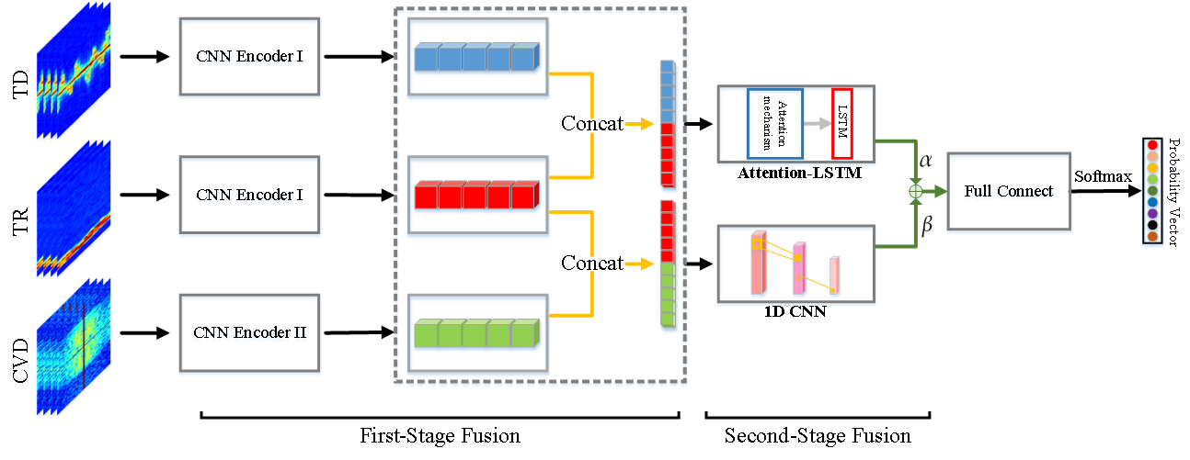
Network Structure
Fig. 11 The proposed two-stage fusion network
In the first-stage fusion, the encoded features of three-domain radar maps along either the temporal or spatial dimension.
In the second-stage fusion, Attention-LSTM and 1D-CNN are used to extract deep information from temporal-fused and spatial-fused features, and trainable weighted average strategy is used to further combine these features.

Slide 13
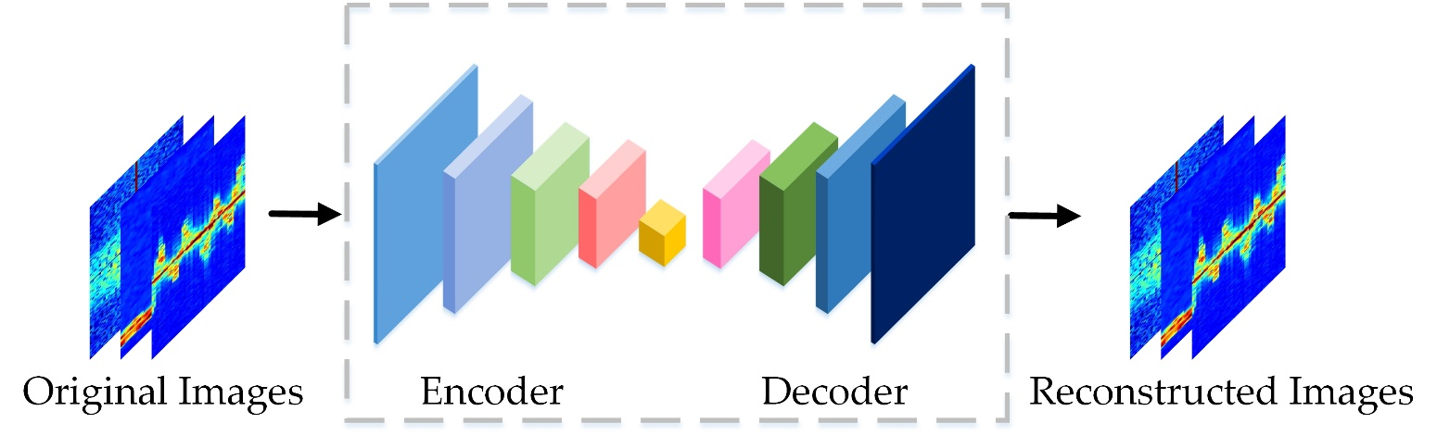
Network Structure
Why use convolution encoder as front extractor?
To preserve main semantic information while extracting features.
To adapt to the first-stage feature alignment structure required.
To mitigate the overfitting problem, which is often seen in small dataset.
Fig.12 Convolution encoder architecture
Work by:

Slide 14
Network Structure
Why use attention-lstm and 1d-cnn as post extractor?
To capture the correlation between local and global temporal information.
To fully extract spatial features within fused 1D image feature sequences.
Fig.13 Attention-LSTM architecture

Slide 15
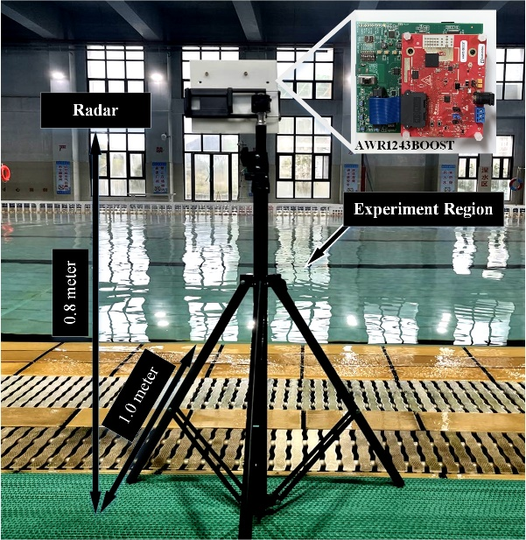
Experimental Analysis
Data Collection
TI AWR1243 Boost mm-wave radar is used in our data acquisition system，whose maximum detectable range is 11(m) and maximum speed is 3(m/s).
To better simulate real situations, two potential drowning activities and seven negative class aquatic human activities are collected in consecutive 20s or 40s.
The collected raw radar data lasts 93 minutes, and the processed offline data with a sample size of 1890 for training set and 464 for test set.
TABLE I
DETAILED INFORMATION OF THE DATASET
Activity Type | # of Data Files | Valid Duration(sec)
Struggle | 32 | 640
Drowning | 40 | 799
Float with Buoys | 30 | 600
Wave for Help | 30 | 600
Swim with Buoys | 13 | 501
Pull Buoys | 20 | 516
Backstroke | 18 | 655
Breaststroke | 18 | 639
Freestyle | 18 | 635
Fig. 14 Field experiment scene

Slide 16
Experimental Analysis
Data Collection
Fig. 15 Snapshot and three-domain radar maps of potential-drowning activities.
The potential drowning behaviors considered are struggling and drowning, both of which are progressive in process.
The energy fluctuation of “drowning” activity is weak intermittently, while the energy fluctuation of “struggling” activity is energy-intensive with a certain periodicity.
The struggling activity exhibits a significant expansion in both the time-range and the time-Doppler maps.

Slide 17
Experimental Analysis
Data Collection
Fig. 16 Snapshot and three-domain radar maps of aquatic activities related to rings.
These three buoy-related activities have significant similarities in the time-range maps, time-Doppler maps and cadence-velocity diagrams, though multiple range trajectories appear in the time-range maps corresponding to the “pulling a buoy” activity.

Slide 18
Experimental Analysis
Data Collection
Fig. 17 Snapshot and three-domain radar maps of aquatic activities related to swimming.
These three swimming-related activities differs in three-domain radar maps. The “freestyle” and “backstroke” activity exhibits strong expansions in range-time maps and doppler-time maps.

Slide 19
Experimental Analysis
Performance Comparison of Different Models
TABLE II
DETAILED INFORMATION OF THE DATASET
Model | Domain | Mean Acc | Min Acc | Max Acc | Var Acc
LSTM | TD | 82.29% | 79.17% | 84.64% | 4.31
Conv1D-LSTM | TD | 84.97% | 82.81% | 86.72% | 1.88
RD-Net | TD | 85.34% | 83.33% | 87.76% | 1.81
RD-Net | TR, TD | 92.94% | 91.67% | 95.05% | 1.46
CNN | TD | 84.74% | 82.29% | 87.50% | 2.60
CNN | TR, TD | 92.19% | 90.89% | 93.49% | 0.68
CNN | TR, TD, CVD | 93.82% | 92.97% | 94.53% | 0.65
MDFRadrNet | TR, TD | 92.32% | 90.89% | 94.53% | 1.13
MDFRadrNet | TR, TD, CVD | 94.33% | 93.49% | 95.05% | 0.21
TSFNet | TR, TD, CVD | 97.08% | 95.31% | 98.44% | 0.83
Multi-domain fusion models outperform the uni-domain models in classification performance, which verify the effectiveness of multi-fusion strategy.
TSFNet has the best classification performance and acceptably low uncertainty.

Slide 20
Experimental Analysis
Confusion Matrix Analysis
TABLE III
CONFUSION MATRICES ANALYSIS
Model | (a) | (b) | (c) | (d) | (e) | (f) | (g) | (h) | (i)
RDNet (TD) | 96.43 | 89.58 | 93.75 | 93.75 | 87.10 | 88.71 | 98.08 | 80.56 | 27.78
RDNet (TR+TD) | 100.00 | 97.92 | 97.92 | 95.31 | 90.32 | 96.77 | 100.00 | 94.44 | 77.78
MDFRadarNet (TR+TD+CVD) | 100.00 | 95.83 | 93.75 | 100.00 | 91.94 | 93.55 | 100.00 | 97.22 | 88.89
TSFNet (TR+TD+CVD) | 100.00 | 100.00 | 97.92 | 100.00 | 95.16 | 95.16 | 100.00 | 100.00 | 94.44
Note: (a) Struggle (b) Wave (c) Float with Buoys (d) Drowning (e) Freestyle (f) Breaststroke (g) Backstroke (h) Swim with buoys (i) Pull buoys.
TSFNet yields higher fine-grained recognition performance with regard to each category of activity, especially in potential drowning activity recognition.

Slide 21
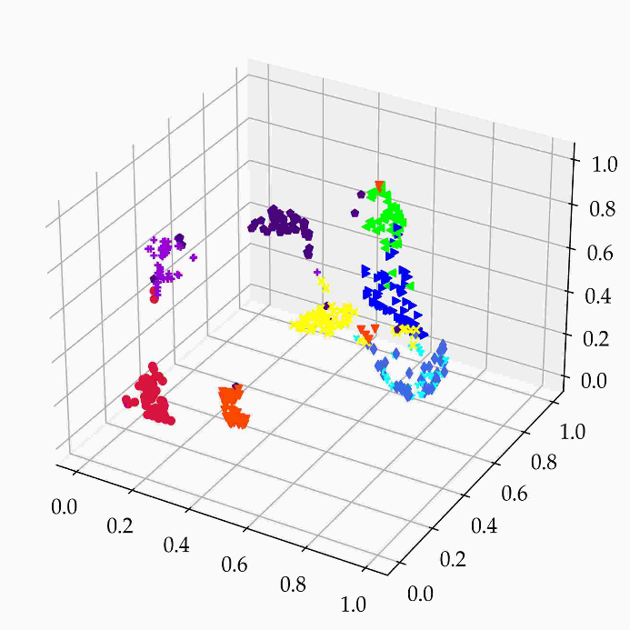
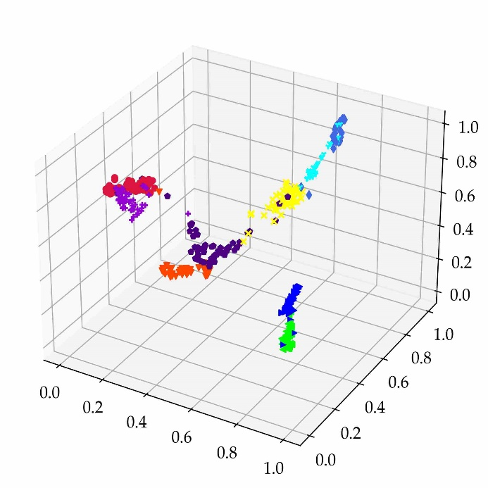
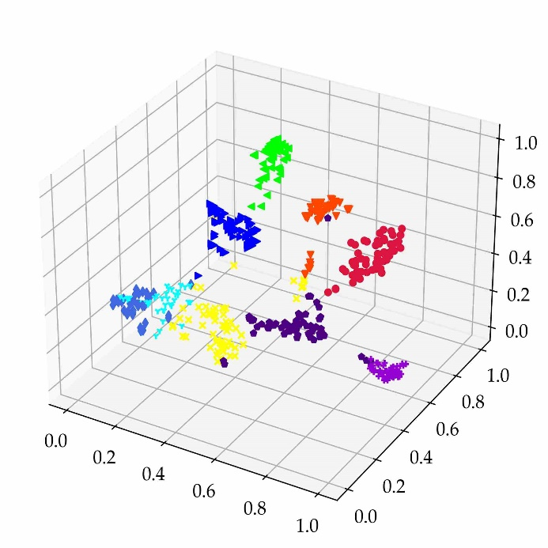
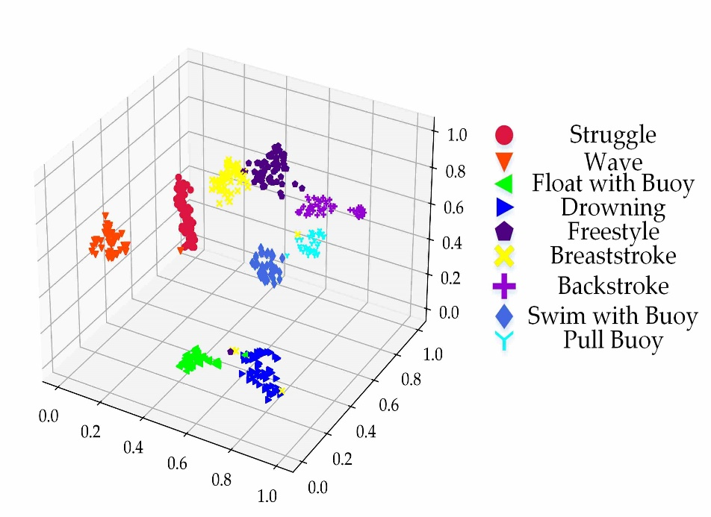
Experimental Analysis
Feature Visualization via t-SNE
Fig. 18 Feature visualization of different models.
(a) RD-NET(TD). (b) RD-NET (TR+TD). (c) MDFRadar (TR+TD+CVD). (d) TSFNet.
The clustering of “pull buoys”, “float with buoys”, “swim with buoys” and “drowning” activity are easily confused with each other in Fig. 17 (a), (b) and (c)
The differentiation between clusters of different categories becomes apparent as the number of fusion domains increases.
The proposed TSFNet has more distinct discrimination boundaries and more compact distribution of in-cluster points.

Slide 22
Conclusion and Future Work
Main Conclusion:
To the best of knowledge, we are the first to propose a novel radar-based drowning detection system, comprising a data acquisition module, a signal processing module, and an event detection module.
In the event detection module, we propose a new multi-domain fusion network by multi-stage and deep integration of different domain features.
The experimental results tested on our collected aquatic human activity (AHAR) dataset verify the proposed TSFNet has remarkable fine-grained classification performance and low model uncertainty.

Slide 23
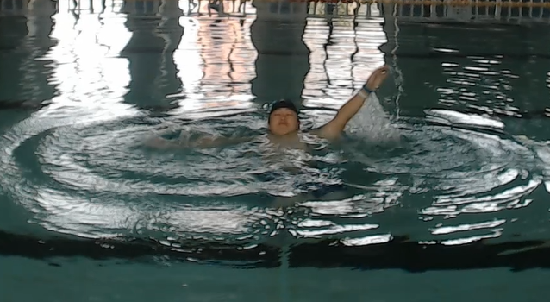
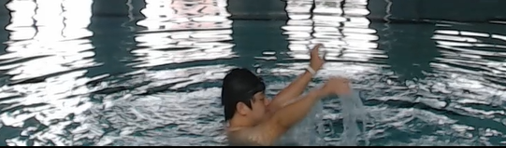
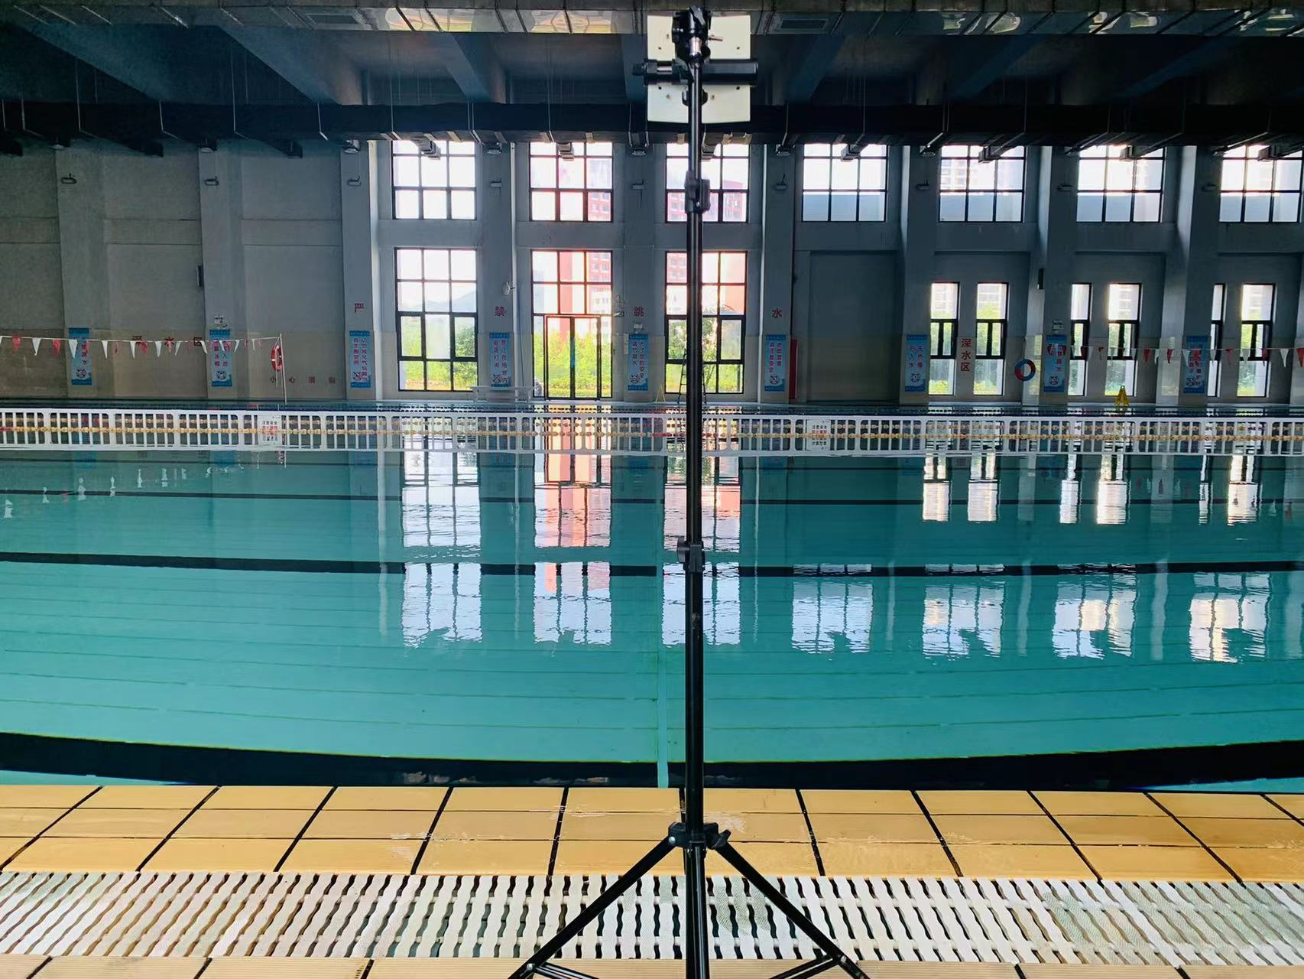
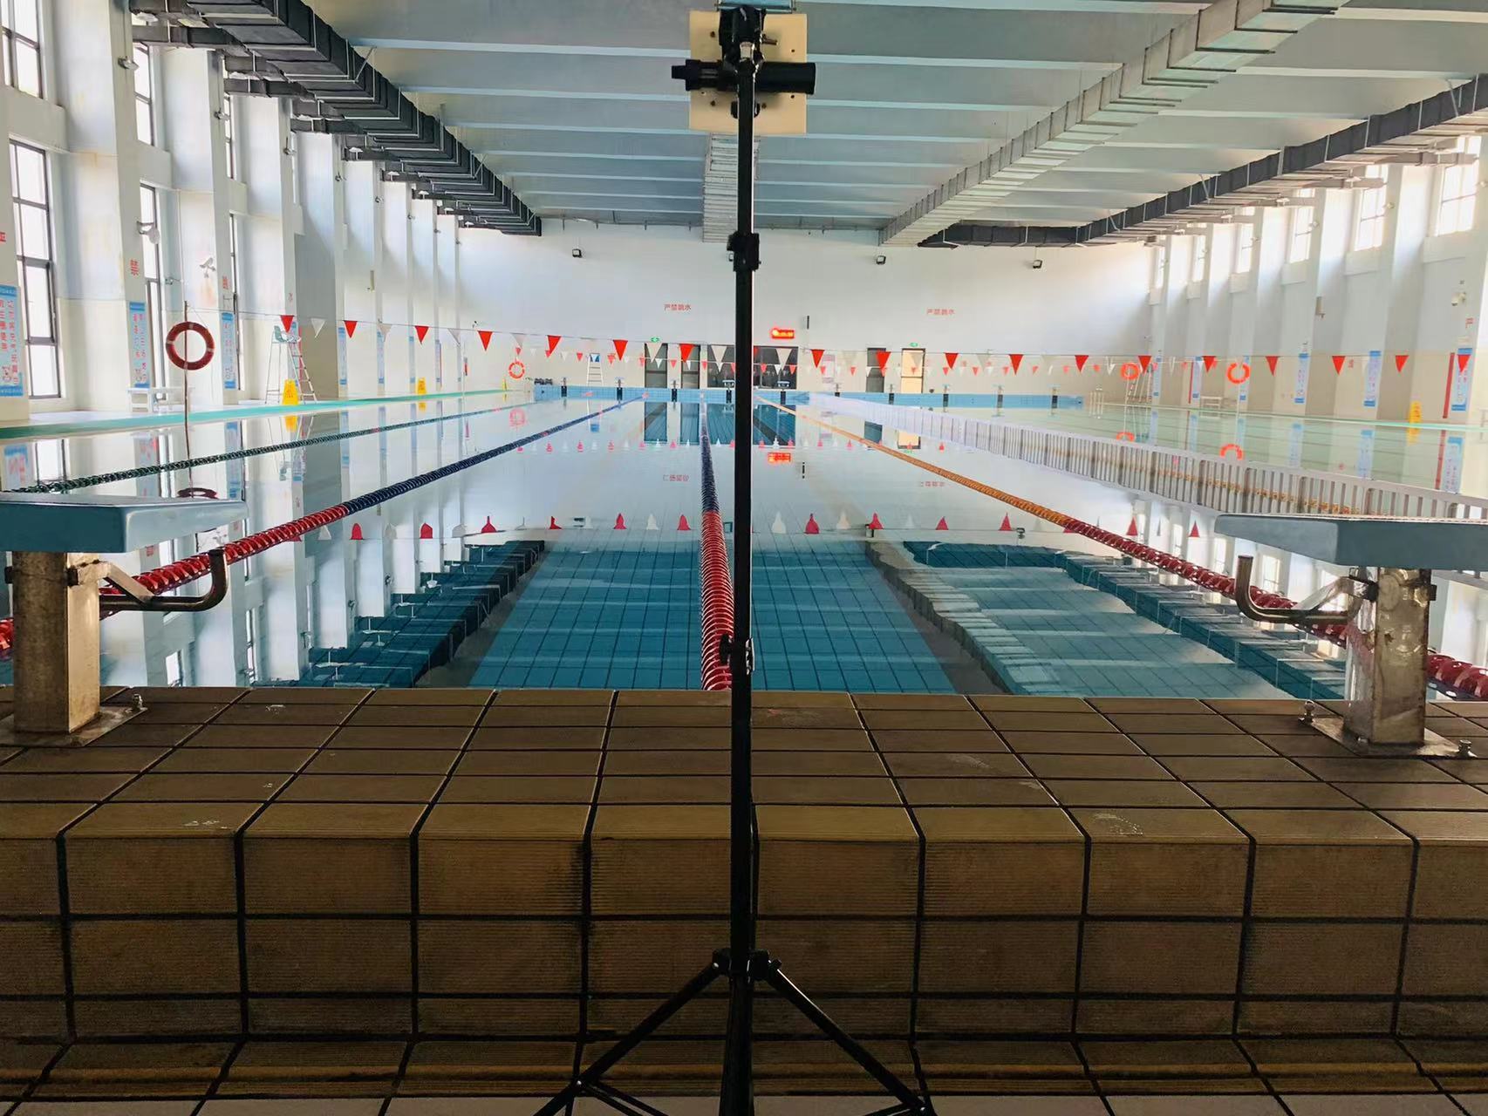
Conclusion and Future Work
What we will do in future work:
We will focus more on early-drowning target detection and recognition in compound water environments and work on establishing a robust and effective adaptive early-drowning detection framework.
Beyond the radar spectrogram modality, we will continue to investigate the potentials of millimeter-wave radar point clouds for aquatic target detection, tracking and identification.
Fig. 19 What we will focus in our future work

Slide 24


Thank you

